Slide 1
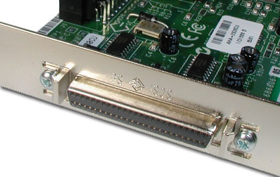
Small Computer System
Interface
BY:
AKANKSHA BUBBER
1RV11CS006
UNDER GUIDANCE OF:
ANJAN K
Assistant Professor
Dept. of CSE
RVCE

Slide 2
Topics Covered
1.Brief description of SCSI.
2.Ten control signals of SCSI.
3.Sequence of operation.
4.Advantages and disadvantages

Slide 3
SCSI
It is a way to transfer data between computers and peripheral devices.
Up to 8 or 16 devices can be attached to a single bus. There can be any number of hosts and peripheral devices but there should be at least one host.
Traditional SCSI interfaces use a parallel interface.
1

Slide 4
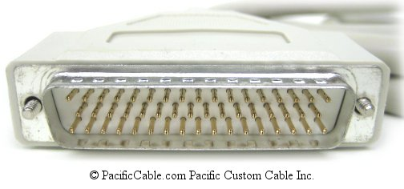
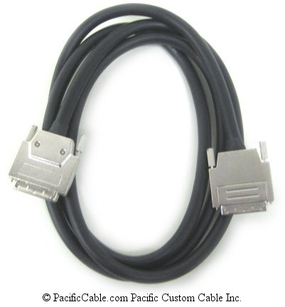
HOW DOES SCSI CABLE LOOK LIKE??
2

Slide 5
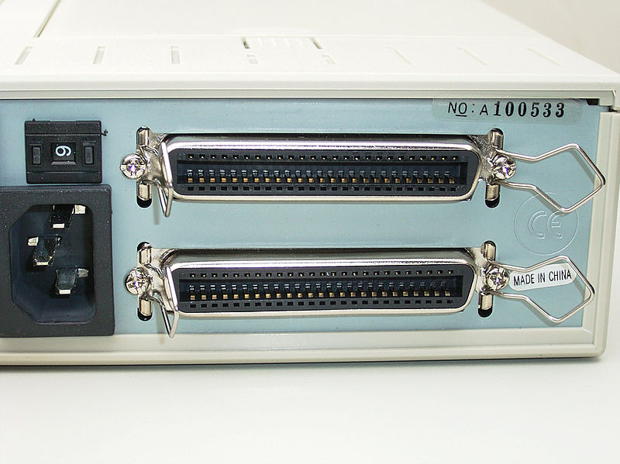
3

Slide 6
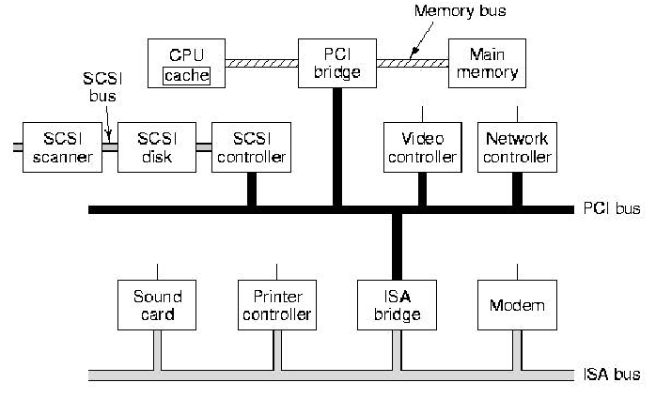
Use of SCSI in a computer system
4

Slide 7
SCSI Ten Control Signals(1of 2)
1. RST—the reset signal activates to bring all devices with SCSI controller to start up state.
2. SEL—when bus is used for selecting an SCSI target (It differs from Poll count, instead of poll count, the controller activates, SEL, the SCSI controller examines SCSI ID and always select the highest ID device
Each SCSI device has a distinct bus request line BRq(i).
3. BSY (for Busy)—when SCSI bus is not available to other device (controller)
4. ATN—activates when a device draws attention before sending a message to a target
5. REQ—like DRQ requests a data transfer by a device with
the SCSI controller
5

Slide 8
SCSI Ten Control Signals(2of 2)
6. ACK—acknowledgement from the SCSI controller that data transfer completes, like DACK
7. MSG—when a message or information is being transferred through the SCSI bus
8. C/D—1 or 0 when a control (command or status) or data word is being transferred,
respectively
9. I/O—1 or 0 when a data is input to SCSI controller or output from the controller, respectively
10. Parity
6

Slide 9
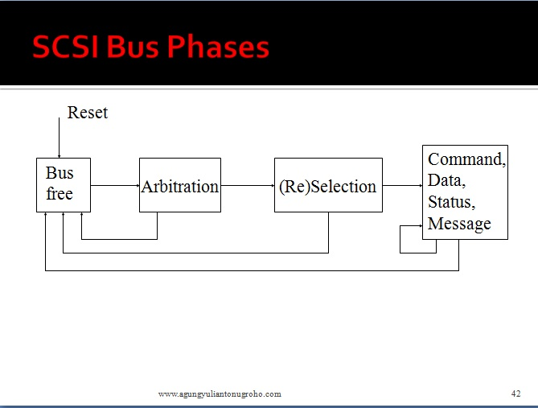
7

Slide 10
Sequence of operation (1of2)
Bus Free: Interrogate the "bus busy" (BSY) signaling line to see whether the bus is in use prior to entering the next phase.
Arbitration: The initiator bids for control of the bus by placing its device ID on the bus and raising the busy signal.
Selection:The address of the target device is placed on the data bus, the "selection" (SEL) signal is raised, and the BSY signal is lowered.
Command: Once the target detects that the initiator has negated the SEL signal, it indicates that it is ready for a command by asserting the "ready for command" signal on the "command/data" (C/D) line, and requests the command itself by raising the REQ signal.
8

Slide 11
Sequence of operation (2of2)
Data:After the target has received the entire command, it places the bus in "data" mode by lowering the C/D signal.
Status: Once all of the data has been transferred, the target places the bus back into command mode by raising the C/D signal.
Message: When the target senses that the initiator is ready, it places the "command complete" code on the data lines and asserts the "message" line, MSG..
Reselection:In the event that a transfer was interrupted (such as when the bus is released while waiting for a disk or tape to service a request), control of the bus is renegotiated through an arbitration phase .
9

Slide 12
Timing diagram
Targets examine ID
D
B
2
D
B
5
D
B
6
B
S
Y
S
E
L
Free
Arbitration
Selection
10

Slide 13
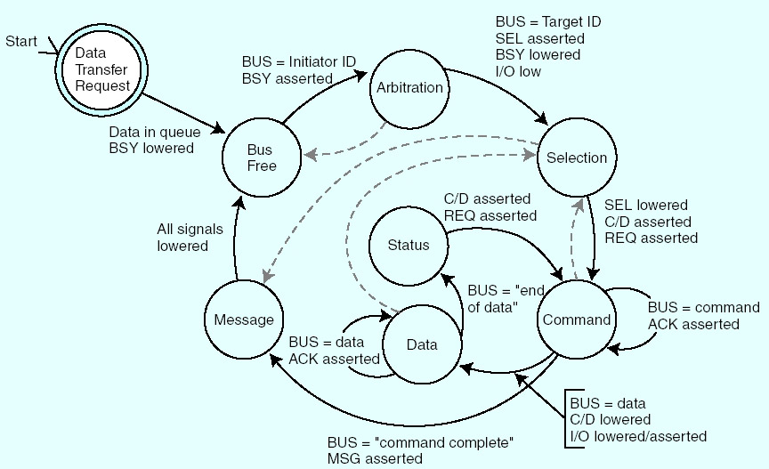
11

Slide 14
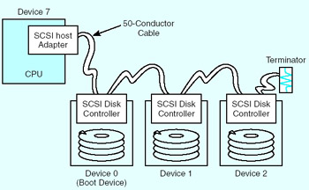
12

Slide 15
Various types of SCSI buses
SCSI designation | Cable pin count | Theoretical maximum transfer rate (MB/sec) | Maximum number of devices
SCSI-1 | 50 | 5 | 8
Fast SCSI | 50 | 10 | 8
Fast and Wide | 2 x 68 | 40 | 32
Ultra SCSI | 2 x 68 or 50 and 68 | 80 | 16
13

Slide 16
Advantages of SCSI
Communicate with the hard disk with bandwidth of 5 MB/s .
• In recent extensions 160 or 320 MB/s bandwidth.
Allow any device on the bus to request the use of the bus
Have a policy for deciding which device gets to use the bus if more than one device wants to access it at the same time.
Data bus has data bus plus parity check bit
Works on double edge clocking.
Others devices can use the bus when connection between initiator and target suspended.
14

Slide 17
SCSI controller arbitration policy
Disadvantage
Starvation
Starvation when a device with a high SCSI ID
can prevent a device with a lower ID from ever getting a chance to use the bus by making repeated requests for the bus .
Can occur any time an arbitration policy always gives one device priority over another.
A solution could be:Some arbitration policies prevent starvation by giving more priority to the devices that have been waiting for the bus longest
15

Slide 18
So far we learnt….
1.Ten control signals .
2.Sequence of operation:
Sequence 0: Arbitration when Busy is not active
Sequence 1: Selection using SEL the selection of signals is done.
Sequence 2: Command or status or data transfer
Sequence 3: Reselection
3.Starvation biggest challenge for SCSI.
16

Slide 19


